Slide 1


Barcelona Supercomputing Center
The Future HPC will be Open
Prof. Mateo Valero
December 14, 2020

Slide 2
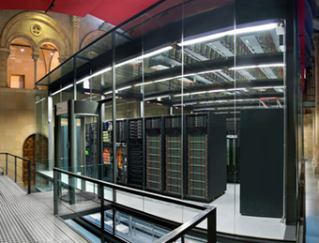





Barcelona Supercomputing Center
Centro Nacional de Supercomputación
BSC-CNS objectives
Supercomputing services
to Spanish and EU researchers
R&D in Computer, Life, Earth and
Engineering Sciences
PhD programme, technology transfer, public engagement
Spanish Government 60%
Catalan Government 30%
Univ. Politècnica de Catalunya (UPC) 10%
BSC-CNS is
a consortium
that includes

Slide 3
People evolution
BSC Staff evolution 2005 - 2020
August 31, 2020
Notes:
87

Slide 4
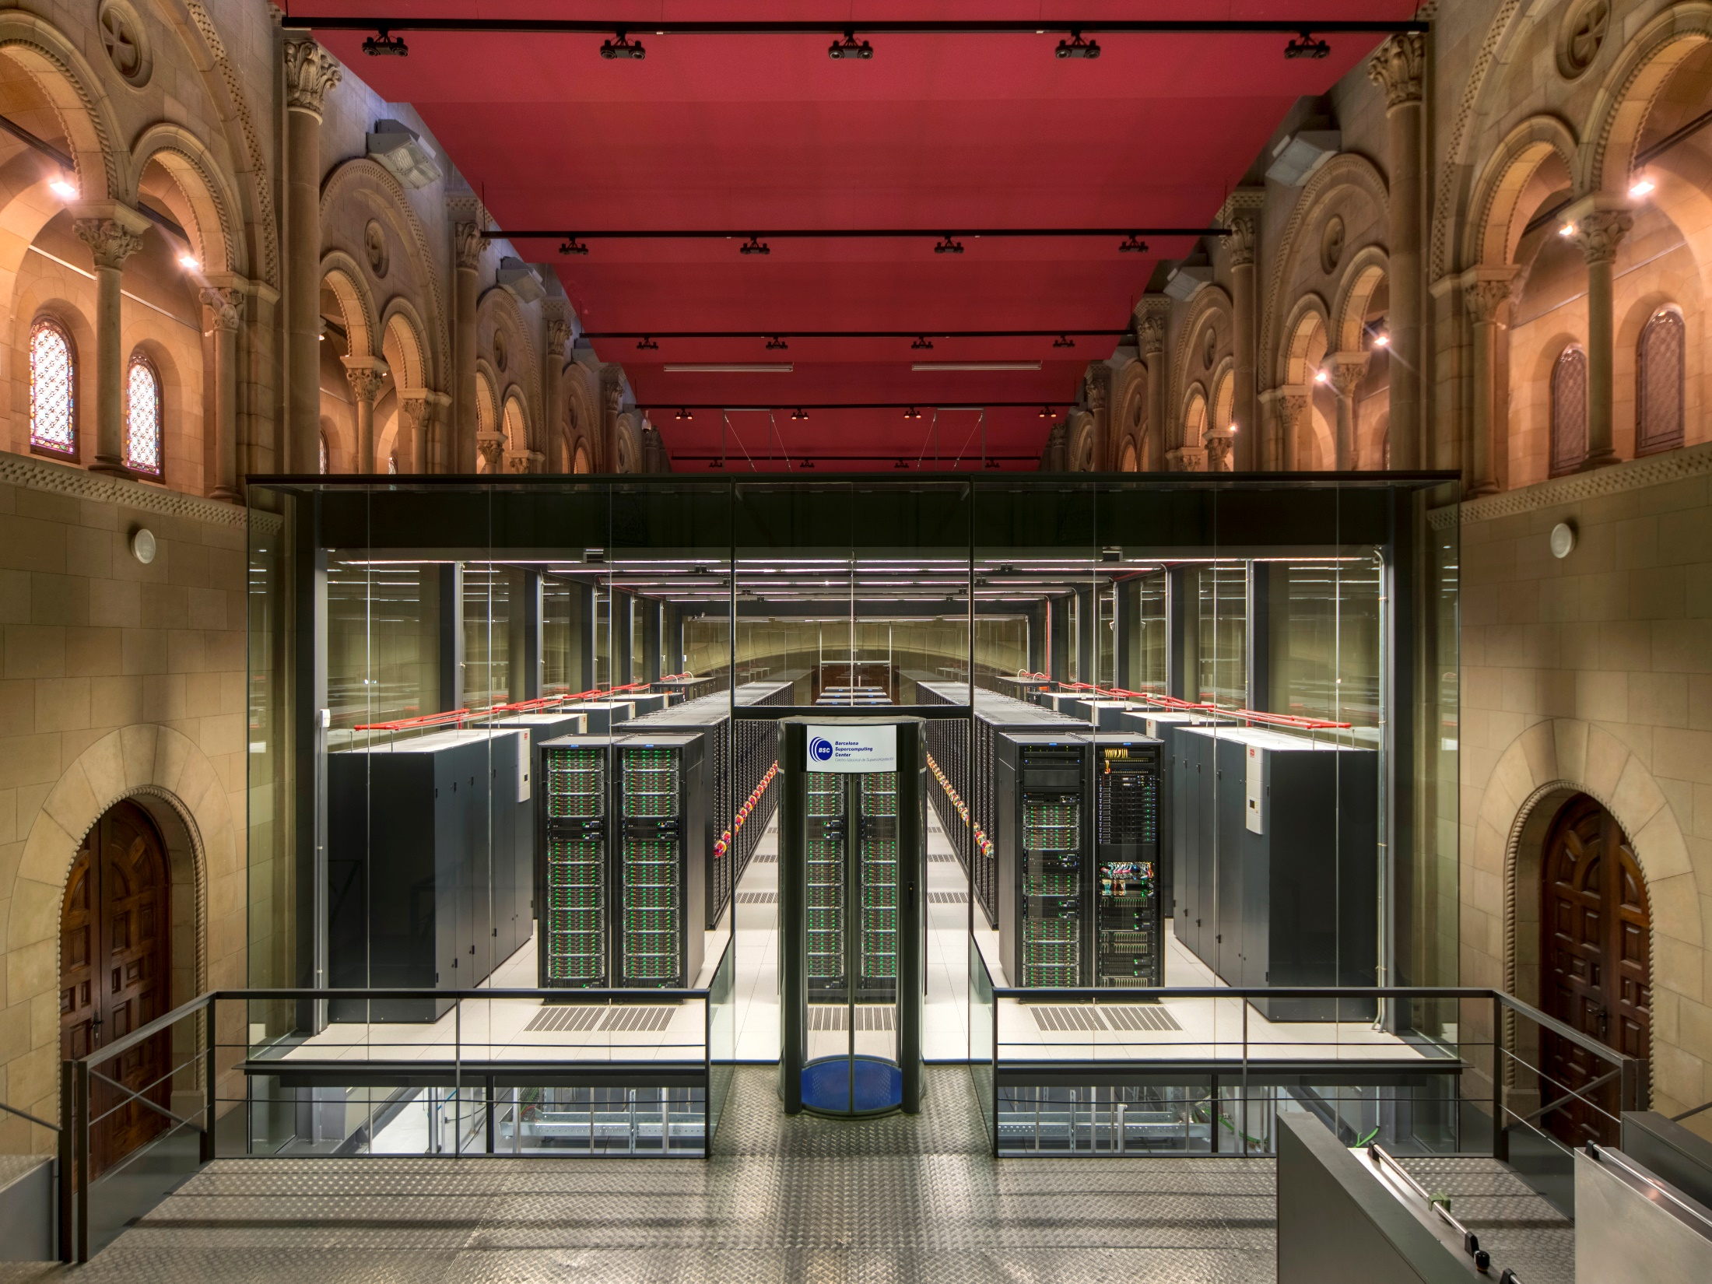
MareNostrum 4
Total peak performance: 13.9 Pflops
General Purpose Cluster: 11.15 Pflops (1-07-2017)
CTE1-P9+Volta: 1.57 Pflops (1-03-2018)
CTE2-Arm V8: 0.65 Pflops (12-2019)
CTE3-AMD: 0.52 Pflops (12-2019)
MareNostrum 1
2004 – 42.3 Tflops
1st Europe / 4th World
New technologies
MareNostrum 2
2006 – 94.2 Tflops
1st Europe / 5th World
New technologies
MareNostrum 3
2012 – 1.1 Pflops
12th Europe / 36th World
MareNostrum 4
2017 – 11.1 Pflops
2nd Europe / 13th World
New technologies

Slide 5



Today´s technology trends
Massive penetration of Open Source Software
  IoT (Arduino),
  Mobile (Android),
  Enterprise (Linux),
  HPC (Linux, OpenMP, etc.)
Moore´s Law + Power = Specialization (HW/SW Co-Design)
  More cost effective
  More performant
  Less Power
New Open Source Hardware Momentum from IoT and the Edge to HPC
  RISC-V
  OpenPOWER
  MIPS

Slide 6
Linux History
1991: Started development, release
1992: X Windows released
1998: Adopted by many major companies
2004: BSC Supercomputer OS
2009: Basis for many new business systems and the cloud
2013: Android in 75% of the world smart phones
2015: De facto OS for IoT, mobile, cloud, and supercomputers

Slide 7
HPC Today
Europe has led the way in defining a common open HPC software ecosystem
Linux is the de facto standard OS despite proprietary alternatives
Software landscape from Cloud to IoT already enjoys the benefit of open source
Open source provides:
  A common platform, specification and interface
  Accelerates building new functionality by leveraging existing components
  Lowers the entry barrier for others to contribute new components
  Crowd-sources solutions for small and larger problems
What about Hardware and in particular, the CPU?
GROMACS,NAMD, WRF, VASP, etc.
Applications
OpenMP
Libraries/Platforms
COMPS
Schedulers
OPEN
LLVM
Compiler/Toolchain
Linux
OS
OCP
HW Systems
CLOSED
CPUs/GPUs/ASICs

Slide 8
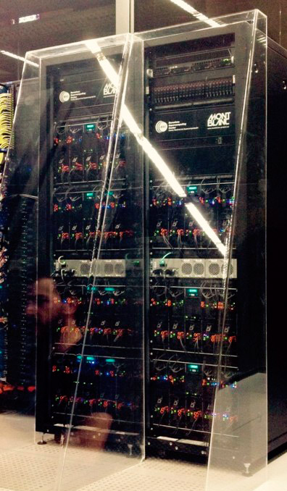



















Mont-Blanc HPC Stack for ARM
Industrial applications
Applications
System software
Hardware

Slide 9
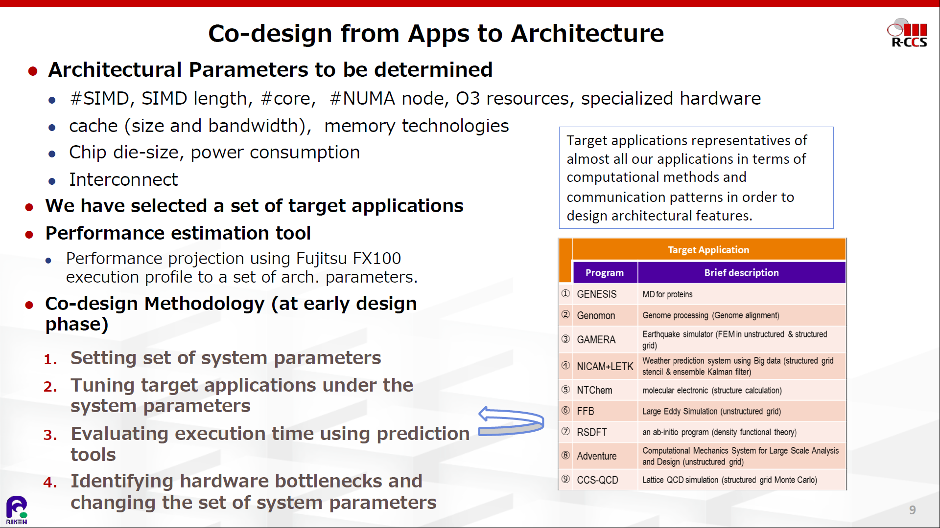
The Exascale Race – The Japanese example

Slide 10
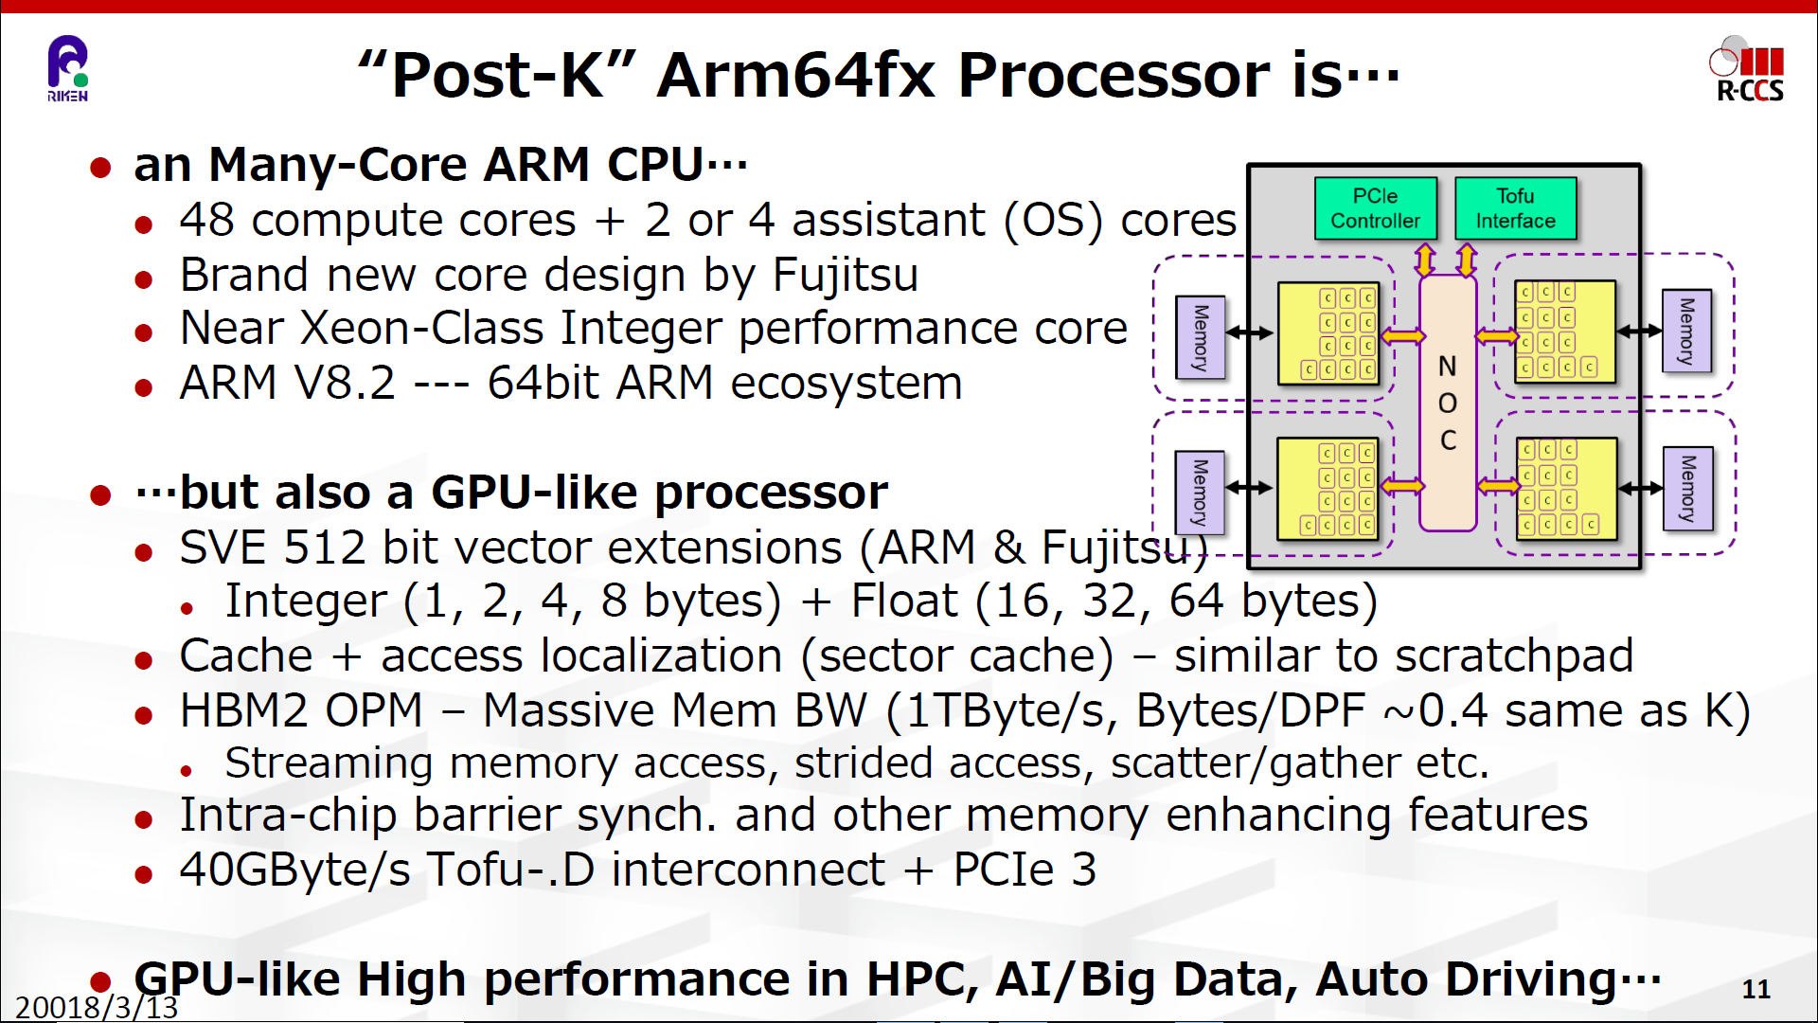
The Exascale Race – The Japanese example

Slide 11
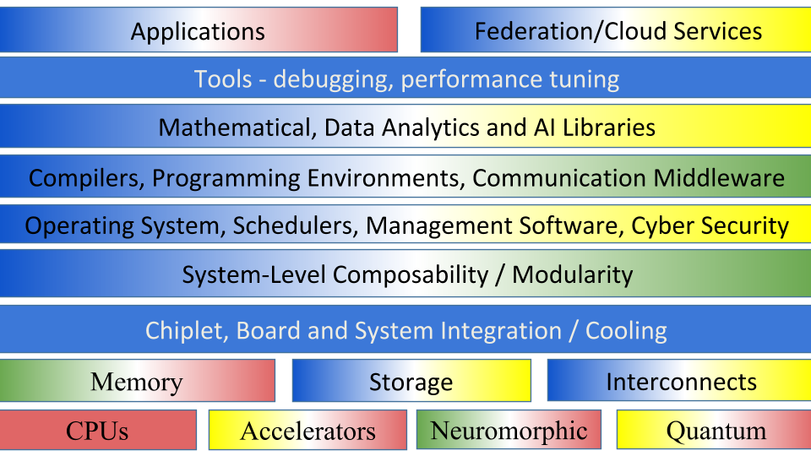
The European Open System Stack
TRL 8-9
TRL 5-7
TRL 3-4
TRL 1-2
Notes:
Blue (TRL 8-9) Mature European technology products that are on-par internationally or
even enjoy supremacy
Green (TRL 5-7) European technology with core European industrial support
less than 2-3 years (short term) away from
product maturity
Yellow (TRL 3-4) European technology with a 5-year roadmap (medium term) to become a
competitive product, supported by industrial partners, with potentially
suitable core competences
Red (TRL 0-2) Technology with low European capability and a >7-year (long term) roadmap toward a competitive product offering with no or very
few mature industrial partners

Slide 12
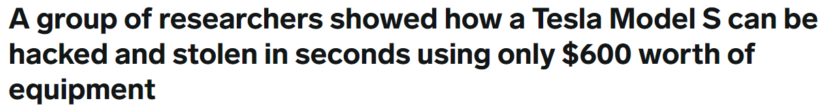
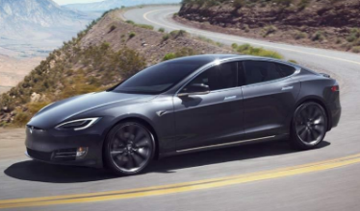
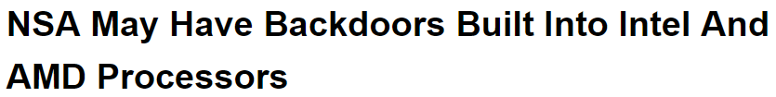


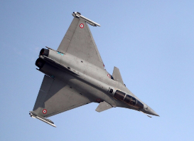








Why Europe needs its own processor
Processors now control almost every aspect of our lives
Security (back doors, etc.)
Possible future restrictions on exports to EU due to increasing protectionism
A competitive EU supply chain for HPC technologies will create jobs and growth in Europe

Slide 13
RISC-V History
2010: Started development and initial proposal
2015: RISC-V Foundation formed
2019: Adopted by many major companies
  Starting in the embedded market with already over 1 Billion CPUs
2020
  RISC-V Foundation moves to Switzerland
The time is now to embrace and support RISC-V from IoT to HPC

Slide 14

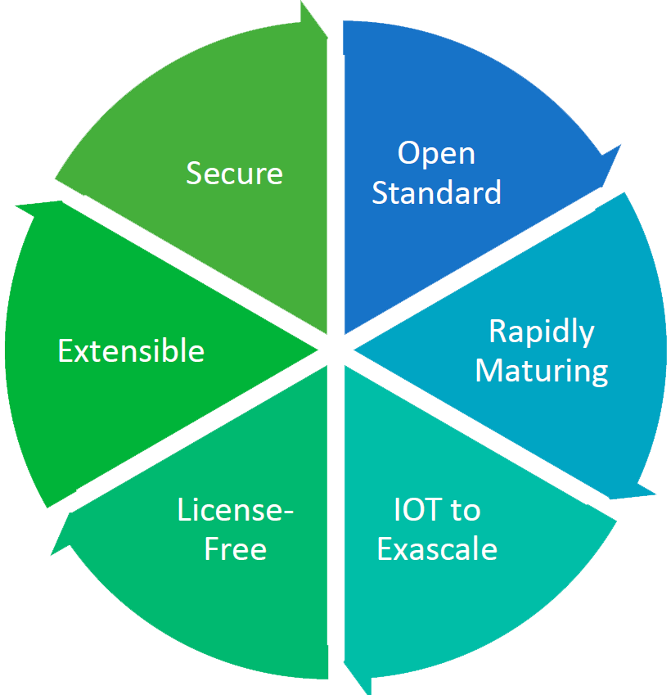

RISC-V is democratizing chip-design
More and more global IT actors are adopting RISC-V architectures to be vendor independent
Google
Amazon
Western Digital
Alibaba
And of course the entire IoT ecosystem for lower performance, lower energy applications.
Major opportunity for ICT industry also in Spain

Slide 15
HPC Tomorrow
Europe can lead the way to a completely open SW/HW stack for the world
RISC-V provides the open source hardware alternative to dominating proprietary non-EU solutions
Europe can achieve complete technology independence with these foundational building blocks
Currently at the same early stage in HW as we were with SW when Linux was adopted many years ago
RISC-V can unify, focus, and build a new microelectronics industry in Europe.
GROMACS,NAMD, WRF, VASP, etc.
Applications
OpenMP
Libraries/Platforms
COMPS
Schedulers
OPEN
LLVM
Compiler/Toolchain
Linux
OS
OCP
HW Systems
RISC-V, OpenPower, MIPS
CPUs/GPUs/ASICs

Slide 16

Open Source Beyond 2020
“Open Source has become mainstream across all sectors of the software industry during the past 10 years. To a large extent, open software re-use has proven economically efficient. The level of maturity of Open Source Hardware (OSH) remains far lower than that of Open Source Software (OSS). However, business ecosystems for OSH are developing fast so that OSH could constitute a cornerstone of the future Internet of Things (IoT) and the future of computing.”
- DG Connect & DG IT Workshop, Brussels, Nov. 14-15, 2019
Source: https://ec.europa.eu/digital-single-market/en/news/workshop-about-future-open-source-software-and-open-source-hardware

Slide 17
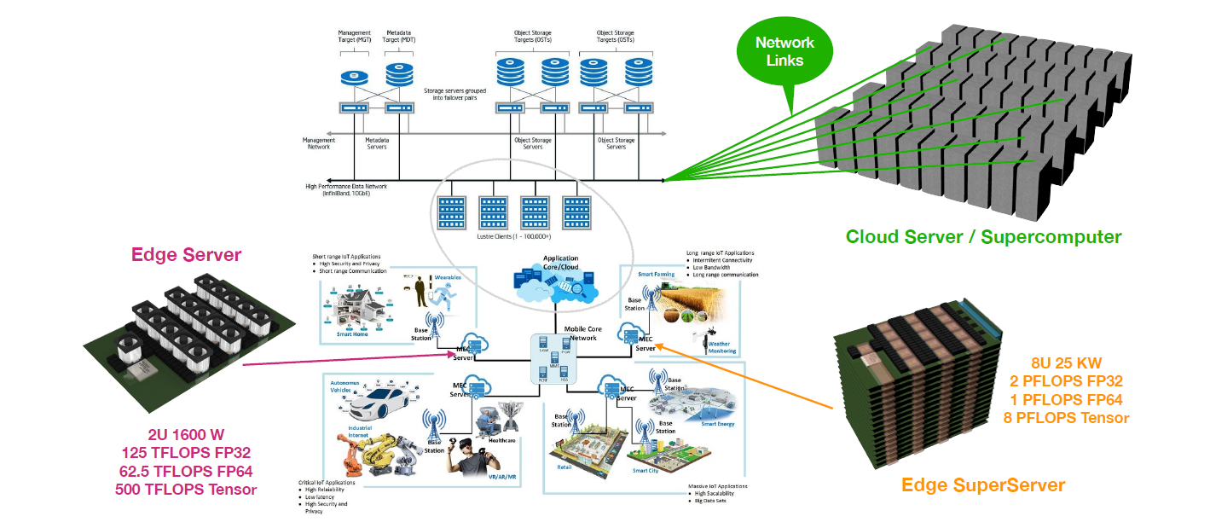
From IoT, Edge Computing, Clouds to Supercomputers

Slide 18
Current BSC RISC-V European Accelerator & CPU Landscape
European Open Source Ecosystem
RISC-V Accelerators
Open Source SW
Open Source HW
RISC-V CPUs
MEEP
EPI - SGA1
EPI - SGA2
The European PILOT (RISC-V)
Note: Collaboration between all RISC-V projects possible
eProcessor
Exploitation
Arm GPP EuroHPC-2020-01 subtopic A

Slide 19
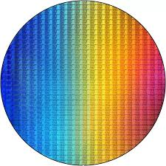


Rebuilding the European CPU Industry
Production
Closed + Open
Open
Research
eProcessor
EPI RISC-V PILOT
Exascale
Design
EPI
MEEP
eProcessor
IP/Infra
IP/Infra
IP/Infra
IP/Infra
This project has received funding from the European Union’s Horizon 2020 research and innovation programme under grant agreement No 826647
The MEEP project has received funding from the European High-Performance Computing Joint Undertaking Joint Undertaking (JU) under grant agreement No 946002. The JU receives support from the European Union’s Horizon 2020 research and innovation programme and Spain, Croatia, Turkey.
Notes:
EPI Phase 1: EPAC RISC-V accelerators: Vector, ML/Stencil, Variable Precision, + shared cache coherent L2, and NoC. Shared Arm infrastructure
MEEP: FPGA emulation platform. ACME Accelerated Compute and Memory Engine: RISC-V accelerator w/ Vector processor + Video and neural network coprocessors.
eProcessor: 2-way OOO RISC-V processor, single core and dual core implementation (tapeout), coherent caches and off-chip coherent link, bioinformatics accelerator
EPI RISC-V Pilot: The European PILOT: Pilot using Local and Open Technologies: 2 All-European IP, independent PCIe 6.0 w/ CXL 3.0 accelerator chiplets, Vector and ML/Stencil (VEC and MLS). Open Compute Platform Infrastructure. Liquid Immersion cooling. Full RISC-V SW stack from GROMACS and EC-EARTH on the VEC side to Video Anomaly Detection, NLP and Machine Learning on the MLS side. Joint HPC +HPDA appt.

Slide 20
The European Processor Initiative
In the same way BSC led the development of ARM processors for HPC in the various MontBlanc projects, now it leads the RISC-V HPC accelerator development in EPI
EPI is a 100% funded EuroHPC project (120 M€ ) to develop European processor technology by 2022
BSC was the original initiator of EPI and most active proponent in the scientific and technical community
EPI is led by Atos/Bull with 27 partners from leading HPC industrial and academic centres

Slide 21

EPI Partners
Notes:
3 new partners
Embedded FPGA
Embedded Security, and especially Secure OS
HW/SW co-design under automotive Functional Safety conditions
Soon a 4th one

Slide 22
EPAC architecture
Objective: Develop & demonstrate fully European processor IPs based on the RISC-V ISA. Build on existing EU IP, leverage EU background and vision
Provide a very low power and high computing throughput accelerator for HPC & Emerging -> Automotive
Main Contributors:
RISC-V in the Tile: 8 Vector cores, 8 STX, 1 VRP
Vector Core :
  Spain + Italy + Croatia
  C: RISC-V Scalar core
  V: RISC-V Vector core: 8 lanes
STX
  Switzerland + Germany
  RISC-V NTX (AI/ML/DL) + Stencil
VRP
  France
  RISCV + Extended precision FPU
L2
HN
L2
HN
L2
HN
HNF
HNF
HNF
GPP world/ ARM
Bridge
RNI
noc
Bridge
RNI
RNF
RNF
RNI
RNI
C
C
STX
STX
VRP
V
V
AXI Lite
Peripherals
Peripherals
Peripherals
UNIBO
IST
CEA
Chalmers
FORTH
Semidynamics
BSC
ETH + FhG
EXTOLL
ETH

Slide 23
Rebuilding the European CPU Industry
Production
Closed + Open
Open
Research
eProcessor
EPI RISC-V PILOT
Exascale
Design
EPI
MEEP
eProcessor
IP/Infra
IP/Infra
IP/Infra
IP/Infra
This project has received funding from the European Union’s Horizon 2020 research and innovation programme under grant agreement No 826647
The MEEP project has received funding from the European High-Performance Computing Joint Undertaking Joint Undertaking (JU) under grant agreement No 946002. The JU receives support from the European Union’s Horizon 2020 research and innovation programme and Spain, Croatia, Turkey.
Notes:
EPI Phase 1: EPAC RISC-V accelerators: Vector, ML/Stencil, Variable Precision, + shared cache coherent L2, and NoC. Shared Arm infrastructure
MEEP: FPGA emulation platform. ACME Accelerated Compute and Memory Engine: RISC-V accelerator w/ Vector processor + Video and neural network coprocessors.
eProcessor: 2-way OOO RISC-V processor, single core and dual core implementation (tapeout), coherent caches and off-chip coherent link, bioinformatics accelerator
EPI RISC-V Pilot: The European PILOT: Pilot using Local and Open Technologies: 2 All-European IP, independent PCIe 6.0 w/ CXL 3.0 accelerator chiplets, Vector and ML/Stencil (VEC and MLS). Open Compute Platform Infrastructure. Liquid Immersion cooling. Full RISC-V SW stack from GROMACS and EC-EARTH on the VEC side to Video Anomaly Detection, NLP and Machine Learning on the MLS side. Joint HPC +HPDA appt.

Slide 24









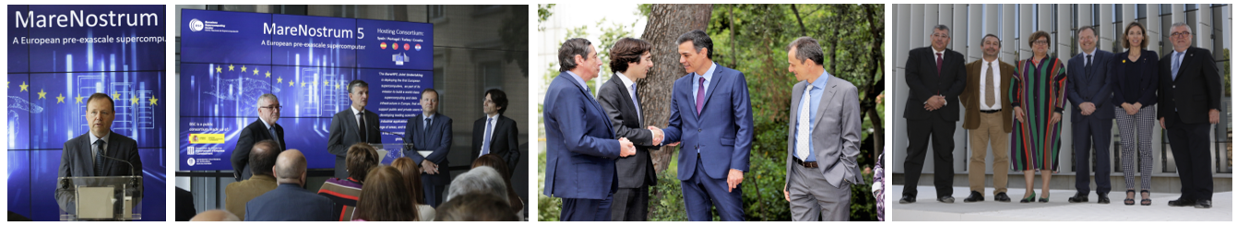

MareNostrum 5. A European pre-exascale supercomputer
Hosting Consortium:
200 Petaflops peak performance (200 x 10¹⁵)
Spain
Portugal
Turkey
Croatia
Experimental platform to create supercomputing technologies “made in Europe”
217 M€ of investment
The acquisition and operation of the EuroHPC supercomputer is funded jointly by the EuroHPC Joint Undertaking, through the European Union’s Connecting Europe Facility and the Horizon 2020 research and innovation programme, as well as the Participating States Spain, Portugal, Croatia, and Turkey

Slide 25







MEEP: MareNostrum Experiment Exascale Platform
MEEP is a flexible FPGA-based emulation platform that will explore hardware/software co-designs for Exascale Supercomputers and other hardware targets, based on European-developed IP. The project provides two functions:
  An evaluation platform of pre-silicon IP and ideas,
  at speed and scale.
  A software development and experimentation
  platform to enable software readiness for new hardware.
MEEP will enable software development, accelerating software maturity, compared to the limitations of software simulation. IP can be tested and validated before moving to silicon, saving time and money.
The MEEP project has received funding from the European High-Performance Computing Joint Undertaking Joint Undertaking (JU) under grant agreement No 946002. The JU receives support from the European Union’s Horizon 2020 research and innovation programme and Spain, Croatia, Turkey.
Notes:
Open Source ISA
RISC-V
Exascale system at less than 30 MW
Reduce the Host CPU tax
Reduce/remove data copying/movement
Support traditional HPC & emerging HPDA (AI/ML/DL)
Accelerate Dense and Sparse workloads
What can be built by industry in 5 years
Host agnostic: Supports ARM, x86, Power and RISC-V
Targeting 5 nm or better, 150 mm sq chiplet
What will we demonstrate in the FPGA
Self-hosted accelerator
No data movement between host and accelerator
Map to a multi-FPGA+HBM emulation platform

Slide 26
Accelerated Compute and Memory Engine (ACME) Architecture
VAS Tile
XP
Core
16 Fused Lane VPU
Core0
L2 Slice
L2 Slice
Core4
L2 Slice
L2 Slice
Scalar Core
CGMT
Core1
L2 Slice
L2 Slice
Core5
L2 Slice
L2 Slice
Core2
L2 Slice
L2 Slice
Core6
Systolic Shell
SerDes
SerDes
HBI
HBI
HBI
HBI
HBI
HBI
HBI
HBI
SerDes
SerDes
L2 Slice
L2 Slice
Systolic Arrays
Core3
L2 Slice
L2 Slice
Core7
L2 Slice
L2 Slice
DFx
L2 I$
JTLB
DB
DB
DB
DB
DB
DB
DB
DB
JTLB
L2 I$
DFx
Shared L2
MC
RB
MCPU
VAS Tile
VAS Tile
VAS Tile
VAS Tile
MCPU
RB
MC
MC
RB
MCPU
MCPU
RB
MC
MC
RB
MCPU
VAS Tile
VAS Tile
VAS Tile
VAS Tile
MCPU
RB
MC
MC
RB
MCPU
MCPU
RB
MC
NVRAM
HBM3+
HBM3,+
NVRAM
MC
RB
MCPU
VAS Tile
VAS Tile
VAS Tile
VAS Tile
MCPU
RB
MC
MC
RB
MCPU
MCPU
RB
MC
MC
RB
MCPU
VAS Tile
VAS Tile
VAS Tile
VAS Tile
MCPU
RB
MC
MC
RB
MCPU
MCPU
RB
MC
DFx
L2 I$
JTLB
DB
DB
DB
DB
DB
DB
DB
DB
JTLB
L2 I$
DFx
SerDes
SerDes
HBI
HBI
HBI
HBI
HBI
HBI
HBI
HBI
SerDes
SerDes
Notes:
Disaggregated Architecture.
Move Memory related compute to the Memory Controller, Memory Contoller CPUs: Process Vector memory requests, especially scatter/gather. Can look into the future.
Use the L3 Cache as a DRAM row buffer cache for virtual, memory interleaving. Leverage the future memory request knowledge to save future DRAM requests to on-chip memory
Assumes we have a limited capability scratchpad to store vectors (stride-1 data) as virtual register info for latter use, DMA/stream into the physical register file. Can make registers longer or add more registers (renaming).
VAS (Vector and Systolic array) Tile: Shared L2, (coherent), private L1$’s, 8 cores with each core containing 8-16 VPUs. VPUs can be split into groups of 2 lanes or phase into a group of 8/16 lanes. Groups are mapped to threads. Many small threads for sparse and 1 thread for dense. Vector length dependent along with the type of parallelism to extract, DLP/TLP, etc.
Assuming Jumb page TLB (1 GB pages, can have large pages (2 MB)).
Shared L2 Instruction cache
Assuming HBM3+ with stacked NVRAM 16/128 GB/chiplet, 8 chiplets/module plus an I/O chiplet
Assuming Mesh NoC between tiles.
PCIe to talk to hosts
3 or more Accelerator-to-accelerator interfaces to scale the number of coherent accelerators.

Slide 27

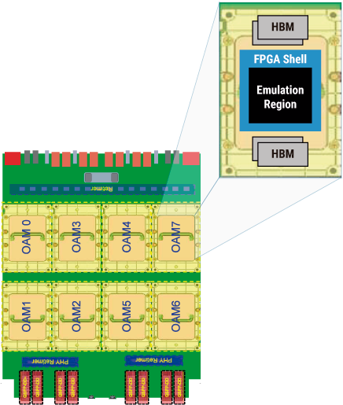


Mapping ACME Architecture to an FPGA
IoT to HPC, AI/ML/DL
SerDes
SerDes
HBI
HBI
HBI
HBI
HBI
HBI
HBI
HBI
SerDes
SerDes
DFx
L2 I$
JTLB
DB
DB
DB
DB
DB
DB
DB
DB
JTLB
L2 I$
DFx
MC
RB
MCPU
VAS Tile
VAS Tile
VAS Tile
VAS Tile
MCPU
RB
MC
LINUX
MC
RB
MCPU
MCPU
RB
MC
MC
RB
MCPU
VAS Tile
VAS Tile
VAS Tile
VAS Tile
MCPU
RB
MC
MC
RB
MCPU
MCPU
RB
MC
NVRAM
HBM3+
HBM3,+
MC
RB
MCPU
VAS Tile
VAS Tile
VAS Tile
MCPU
RB
NVRAM
VAS Tile
MC
MC
RB
MCPU
MCPU
RB
MC
MC
RB
MCPU
VAS Tile
VAS Tile
VAS Tile
VAS Tile
MCPU
RB
MC
MC
RB
MCPU
MCPU
RB
MC
DFx
L2 I$
JTLB
DB
DB
DB
DB
DB
DB
DB
DB
JTLB
L2 I$
DFx
SerDes
SerDes
HBI
HBI
HBI
HBI
HBI
HBI
HBI
HBI
SerDes
SerDes

Slide 28
Rebuilding the European CPU Industry
Production
Closed + Open
Open
Research
eProcessor
EPI RISC-V PILOT
Exascale
Design
EPI
MEEP
eProcessor
IP/Infra
IP/Infra
IP/Infra
IP/Infra
This project has received funding from the European Union’s Horizon 2020 research and innovation programme under grant agreement No 826647
The MEEP project has received funding from the European High-Performance Computing Joint Undertaking Joint Undertaking (JU) under grant agreement No 946002. The JU receives support from the European Union’s Horizon 2020 research and innovation programme and Spain, Croatia, Turkey.
Notes:
EPI Phase 1: EPAC RISC-V accelerators: Vector, ML/Stencil, Variable Precision, + shared cache coherent L2, and NoC. Shared Arm infrastructure
MEEP: FPGA emulation platform. ACME Accelerated Compute and Memory Engine: RISC-V accelerator w/ Vector processor + Video and neural network coprocessors.
eProcessor: 2-way OOO RISC-V processor, single core and dual core implementation (tapeout), coherent caches and off-chip coherent link, bioinformatics accelerator
EPI RISC-V Pilot: The European PILOT: Pilot using Local and Open Technologies: 2 All-European IP, independent PCIe 6.0 w/ CXL 3.0 accelerator chiplets, Vector and ML/Stencil (VEC and MLS). Open Compute Platform Infrastructure. Liquid Immersion cooling. Full RISC-V SW stack from GROMACS and EC-EARTH on the VEC side to Video Anomaly Detection, NLP and Machine Learning on the MLS side. Joint HPC +HPDA appt.

Slide 29
eProcessor Stack
HPC
Applications
Middleware
AI
Applications
Middleware
Bioinformatics
Applications
Middleware
Tools (compiler, performance monitoring, debugging)
Runtime (OpenMP, Tensorflow, Apache Spark, etc.)
Linux
Fault Tolerance
64,32,16-bit mixed precision
8, 4, 3, 2, 1-bit mixed precision
2-way OOO Multicore + Adaptive caches and scratch pad
+ Bioinformatics Accelerator + Low Power

Slide 30









eProcessor System diagram
Coherent off-chip interface
HPC/HPDA SW
LEGaTO PCB
CPU0
CPU1
CPU0
Accel
Core
Core
Core
Core
Accel
Sys SW
Core
Core
Core
Core
Accel
Accel
Accel
Accel
Accel
Accel
(A)
(B)
interconnect
Notes:
2-way OOO RISC-V core
Adaptive caches and scratch pad
Multi-core implementation
On-chip coprocessor interface
Bioinformatics accelerator
Coherent off-chip interface
Multi-socket implementation
COM Express PCB implement to leverage LEGaTO HPC infrastructure
Fault-tolerance
Energy-efficient error detection and lossy checkpointing

Slide 31
Rebuilding the European CPU Industry
Production
Closed + Open
Open
Research
eProcessor
EPI RISC-V PILOT
Exascale
Design
EPI
MEEP
eProcessor
IP/Infra
IP/Infra
IP/Infra
IP/Infra
This project has received funding from the European Union’s Horizon 2020 research and innovation programme under grant agreement No 826647
The MEEP project has received funding from the European High-Performance Computing Joint Undertaking Joint Undertaking (JU) under grant agreement No 946002. The JU receives support from the European Union’s Horizon 2020 research and innovation programme and Spain, Croatia, Turkey.
Notes:
EPI Phase 1: EPAC RISC-V accelerators: Vector, ML/Stencil, Variable Precision, + shared cache coherent L2, and NoC. Shared Arm infrastructure
MEEP: FPGA emulation platform. ACME Accelerated Compute and Memory Engine: RISC-V accelerator w/ Vector processor + Video and neural network coprocessors.
eProcessor: 2-way OOO RISC-V processor, single core and dual core implementation (tapeout), coherent caches and off-chip coherent link, bioinformatics accelerator
EPI RISC-V Pilot: The European PILOT: Pilot using Local and Open Technologies: 2 All-European IP, independent PCIe 6.0 w/ CXL 3.0 accelerator chiplets, Vector and ML/Stencil (VEC and MLS). Open Compute Platform Infrastructure. Liquid Immersion cooling. Full RISC-V SW stack from GROMACS and EC-EARTH on the VEC side to Video Anomaly Detection, NLP and Machine Learning on the MLS side. Joint HPC +HPDA appt.

Slide 32
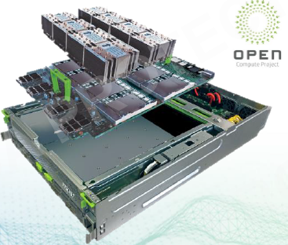
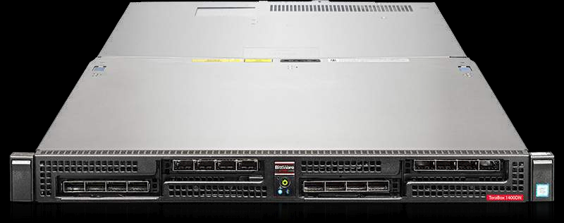

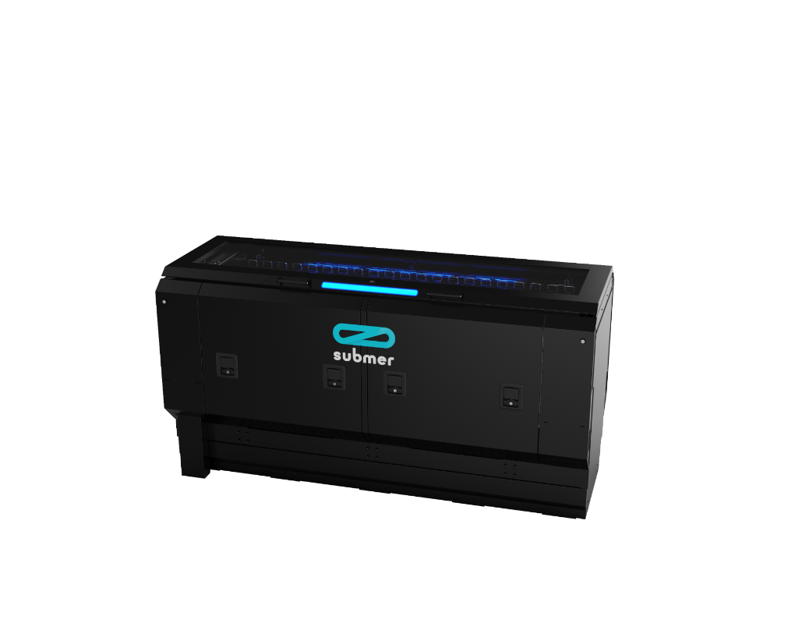

The European PILOT
Stream 2: PILOT SW Stack
Accelerator Chassis
Stream 4: European PILOT
HPC Vector
ML/AI/Stencil
Video
BERT
Applications:
GROMACS
EC-EARTH
MD + AI
Arm (Rhea, etc.) and/or x86 host
SW Libraries:
FFT
Video
BLIS
Neural Net
+
oneDNN
MLS-DNN
AI Framework:
Tarantella
Tensorflow
Dace
MPI
Runtime &
Schedulers:
OpenMP
DLB
TAMPI
System SW:
BeeGFS
SLURM
DROM
Boot, Drivers, Linux
BBQUE
Toolchain:
Inference Engine
LLVM
Stream 3: European RISC-V Accelerators
VEC Accel
MLS Accel
Accelerator Chips
VEC
MLS
Immersive Cooling
Accelerator PCB Cards

Slide 33













The European PILOT Accelerator Architecture
Accelerator Chiplet
Sea of Compute Tiles
Common Uncore
AXI
IOTile
Compute
Tile
Compute
Tile
Compute
Tile
Compute
Tile
PCIe w/CXL
Serdes Phy
32Gbps
CHI
CHI
C2C Bridge
Serdes Phy
32Gbps
PCB
Compute
Tile
Compute
Tile
Compute
Tile
Compute
Tile
C2C Bridge
Serdes Phy
32Gbps
FPGA or PCIe Switch
CHI
CHI
C2C Bridge
Serdes Phy
32Gbps
LPDDR4
x64
C0
C2
LPDDR4
x64
Compute
Tile
Compute
Tile
Compute
Tile
Compute
Tile
LPDDR Ctrl
X16 Phy
33GB/s
33GB/s
AXI5
AXI5
LPDDR Ctrl
X16 Phy
LPDDR4
x64
C1
C3
LPDDR4
x64
Compute
Tile
Compute
Tile
Compute
Tile
Compute
Tile
33GB/s
33GB/s
AXI5
LPDDR Ctrl
X16 Phy
AXI5
LPDDR Ctrl
X16 Phy
Accelerator Card
  3 C2C interfaces per chiplet, 8 lanes each
  1 PCIe 6.0 w/ CXL 3.0 interface per chiplet, 4 lanes
  4 x16 LPDDR controllers per chiplet
  Homogeneous or Heterogeneous PCB
  Optional FPGA/PCIe Switch
VEC
ALL
Compute
Tiles
OR
MLS

Slide 34
Rebuilding the European CPU Industry
Production
Closed + Open
Open
Research
eProcessor
EPI RISC-V PILOT
Exascale
Design
EPI
MEEP
eProcessor
IP/Infra
IP/Infra
IP/Infra
IP/Infra
This project has received funding from the European Union’s Horizon 2020 research and innovation programme under grant agreement No 826647
The MEEP project has received funding from the European High-Performance Computing Joint Undertaking Joint Undertaking (JU) under grant agreement No 946002. The JU receives support from the European Union’s Horizon 2020 research and innovation programme and Spain, Croatia, Turkey.
Notes:
EPI Phase 1: EPAC RISC-V accelerators: Vector, ML/Stencil, Variable Precision, + shared cache coherent L2, and NoC. Shared Arm infrastructure
MEEP: FPGA emulation platform. ACME Accelerated Compute and Memory Engine: RISC-V accelerator w/ Vector processor + Video and neural network coprocessors.
eProcessor: 2-way OOO RISC-V processor, single core and dual core implementation (tapeout), coherent caches and off-chip coherent link, bioinformatics accelerator
EPI RISC-V Pilot: The European PILOT: Pilot using Local and Open Technologies: 2 All-European IP, independent PCIe 6.0 w/ CXL 3.0 accelerator chiplets, Vector and ML/Stencil (VEC and MLS). Open Compute Platform Infrastructure. Liquid Immersion cooling. Full RISC-V SW stack from GROMACS and EC-EARTH on the VEC side to Video Anomaly Detection, NLP and Machine Learning on the MLS side. Joint HPC +HPDA appt.

Slide 35
The Future: Flagship RISC-V Exascale Accelerator
European Open Source Ecosystem
RISC-V Accelerators
Open Source SW
Open Source HW
RISC-V CPUs
MEEP
EPI - SGA1
EPI - SGA2
The European PILOT (RISC-V)
Note: Collaboration between all RISC-V projects possible
Flagship Accelerator Program (RISC-V)
Flagship CPU Program (RISC-V)
eProcessor
Exploitation
Arm GPP EuroHPC-2020-01 subtopic A
Notes:
5 year flagship accelerator project
7 year flagship CPU project

Slide 36
A Successful EC Roadmap for the Future
Embrace Open Source Hardware
  Build infrastructure to support open source
  Create an environment that links research to the ICT industry
  Supported by DG Connect and DG IT
Teach, train, and collaborate
Leverage the Global Technology ecosystem
Requires SIGNIFICANT funding for programs to build made in Europe IP
  Many focused projects: Horizon Europe, Digital Europe, …
  Many focused teams: Collaborative IP and TRL development
  Total and integrated vision for the future
  Large Accelerator and CPU investment (> 1B€)

Slide 37
The Future is Wide Open!
There is an urgent need, from mobile phones to supercomputers: more compute at lower power
The RISC-V ecosystem is in the nascent period where it can become the de facto open hardware platform of the future
An opportunity for Europe to lead the charge to creating a full stack solution for everything, from supercomputers down to IoT devices
Our main goal: Create European chips that meet the needs of future European and global markets across HPC, cloud, automotive, mobile to IoT
This is the framework for the Exascale Supercomputing Initiative at BSC

Slide 38

LOCA @ BSC

Slide 39



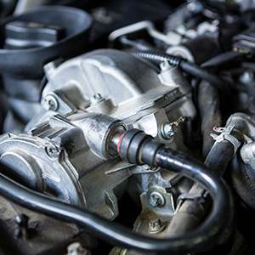
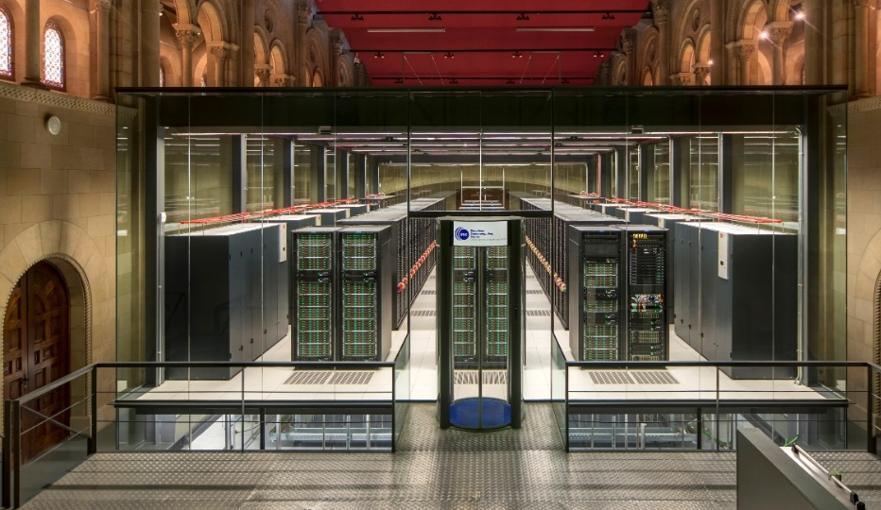


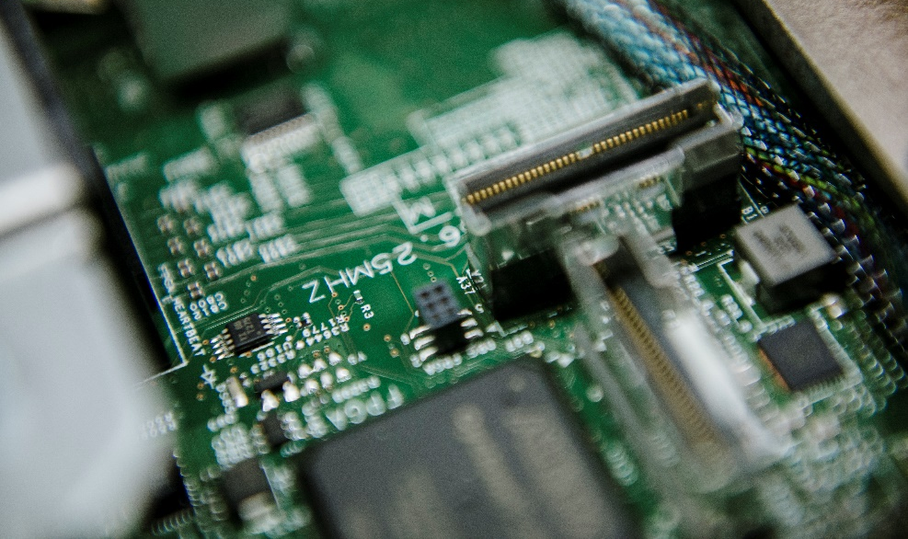

BSC full stack
SW
HPC Applications
Software/Hardware
Co-Design
Specialization using
HW/SW Co-Design
Missing Hardware Design
& Implementation Piece
HW
HPC Hardware
Hardware

Slide 40

LOCA Goals
Mechanism to extend open source ecosystem to include H/W
  Add H/W expertise to BSC and European partners, leverage existing S/W expertise
  Provide proven/usable Open Source H/W
  Intersection of academia and industry
  Open European IP repository → rapid implementation
  Catalyst to reinvigorate European ICT industry
  Global collaboration and training center
  Incubator for European IP

Slide 41

European Collaboration & Education
Traditional chip design is done in a Master/Apprentice environment
LOCA recreates this environment by bringing in Masters from industry to collaborate with a variety of people, pushing beyond RTL
Professors, students, and industry veterans all together
Ideal sandbox for creative and innovative work
Research and Design to chip fabrication
Casteller
(human tower)

Slide 42

LOCA is Bigger than Barcelona!
European
Open Hardware,
Architecture
Initiative
Casteller
(human tower)
We must stand on the shoulders of giants to build great things. We are assembling many giants and hope you can join us.

Slide 43
Thank you
mateo.valero@bsc.es

